Slide 1

Health Insurance Claim Prediction

Slide 2
Problem Statement
The objective of this analysis is to determine the characteristics of people with high individual medical costs billed by health insurance. Also with the characteristics we have to identify if the person will make a health insurance claim.

Slide 3
Customer data-overview
Data | Description
age | Age of policyholder
sex | Gender of policy holder (female=0, male=1)
bmi | Body mass index( ideally 18.5 to 25)
steps | Average walking steps per day of policyholder
children | Number of children / dependents of policyholder
smoker | Smoking state of policyholder (non-smoke=0;smoker=1)
region | The residential area of policyholder in the US (northeast=0, northwest=1, southeast=2, southwest=3)
charges | Individual medical costs billed by health insurance
insuranceclaim | Is there a claim made(yes=1, no=0)

Slide 4
Step1:To analyze the characteristics of people with higher claim charges.

Slide 5
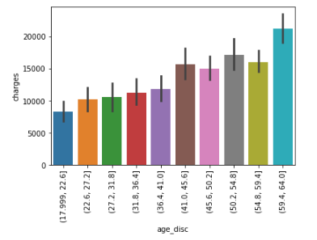
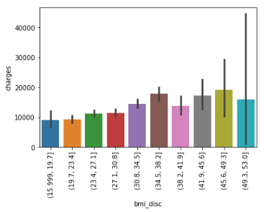
Higher claim charges: Age >40 and bmi>42
For age above 40, the maximum claim charge is above 15k.Whereas in below 40 age category maximum claim is below 15k.
BMI below 42 has maximum claim charges under 20k, whereas bmi above 42 has maximum claim charges above 20k.

Slide 6
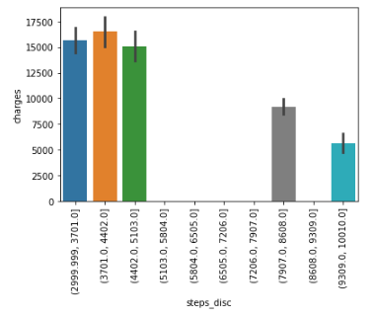
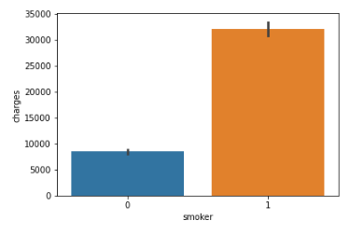
Higher claim charges: steps <5000 and smoker=1
When the steps count is less than 5000,claim charges are above 15k.For steps above 5000 claim charges are under 10k.
Smokers have high claim charges upto 30000 whereas non-smokers have very less claim charges around 10k.

Slide 7
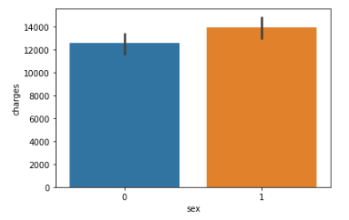
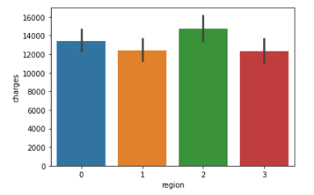
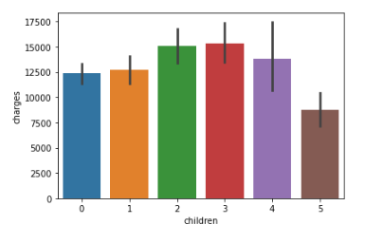
Sex, region and children-No impact on higher claim charges
Male(1) customers have slightly higher claim charges compared to female customers.
All regions have the maximum claim amount in the range of 14-16 k.
Children 2,3 and 4 categories have slightly higher claim charges compared to 0,1 and 5 categories. Category 5 has comparatively less claim charges but it has only 1.3% of the population

Slide 8
Step2:To analyze the category of people making insurance claim.

Slide 9
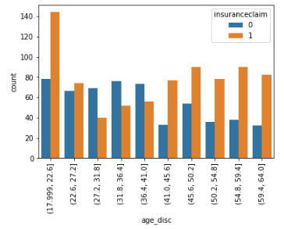
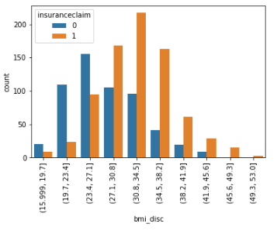
Age, bmi -significant impact on claim made.
Age less than 22 and above 41 categories have around 60 to 70 percent of people making insurance claims.
BMI greater than 27 has 60-80 percentage of people who have made insurance claim.BMI more than 45 category has 100 percent of people making insurance claims.

Slide 10
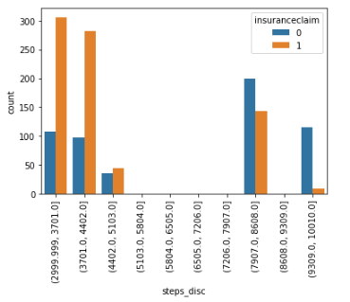
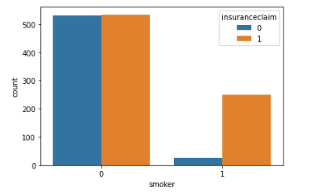
Steps, smoker-significant impact on claim made.
Steps less than 5000 have greater percentage of people making insurance claims(55-74%).Steps above 7900 have 6-41% of people making claims.
90 percent people in smoker category have made insurance claim. In non-smoker it is 50%.

Slide 11
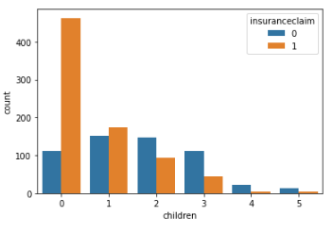
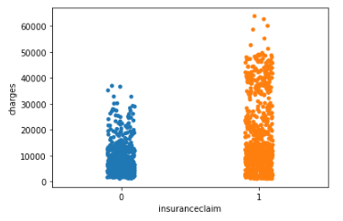
Children, charges-significant impact on claim made.
Children 0 category have 80 percentage of people who have made claim compared to other categories.
All people who have not made any claim have charges less than 40k.Above 40k 100 percent of people have made claims.

Slide 12
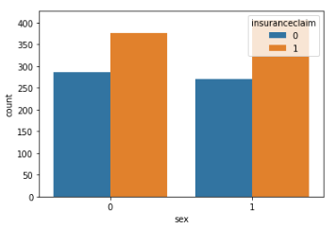
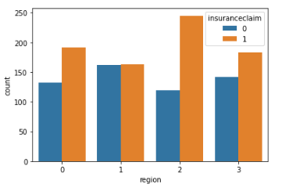
Sex, region-negligible impact on claim made.
All region categories have greater than 50 percent of people making claims.
Both male and female customers have same percentage of people making insurance claim.(56-60%).

Slide 13
Conclusion
Characteristics of people with higher claim charges are:
Age greater than 40
BMI greater than 42
Steps less than 5000
Features affecting insurance claim are:
Age
BMI
Steps
Smoker
Children
Charges
90 percent of smokers have the health insurance claimed.
Charges greater than 40k defaults to claim made.

